Slide 1

Boston Housing Data Analysis

Slide 2
Methods Used : Regression, Cross Validation and CART models
Submitted by:
Aman Singh Pawar

Slide 3
Objective:
To analyze well-known Boston data set and build regression models using Regression, Cross Validation and CART techniques and compare the individual model performance based on MSE parameter.
Steps:
Randomly sampled data in to 80% training and 20% testing sets.
Found optimal number of variables, using best subset method.
Built regression model with possible variables that lead to best fit of the model. Observed the best fit parameters on testing data.
Using 10 fold cross validation technique, partitioned the data in to 10 groups and identified the model parameters (MSE, AIC, BIC) and compared with the regression model parameters.
Fitted another regression on the same data using CART approach and compared results with regression model for the best fit on testing data.
Repeated all the above steps using another sample data sampled in 70%, 30% ratio.

Slide 4
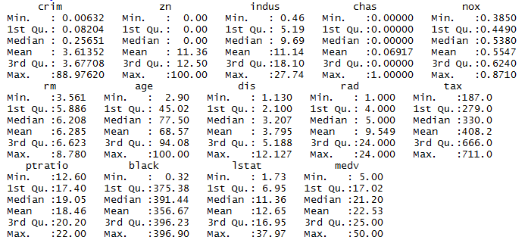
Exploratory Data Analysis:
A quick view summary statistics of the data set

Slide 5
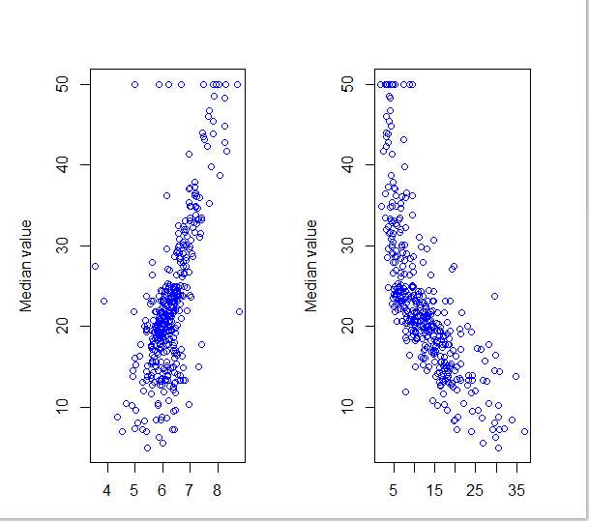
Exploratory Data Analysis Continued:
Correlation Plots
Average no of rooms
lstat

Slide 6
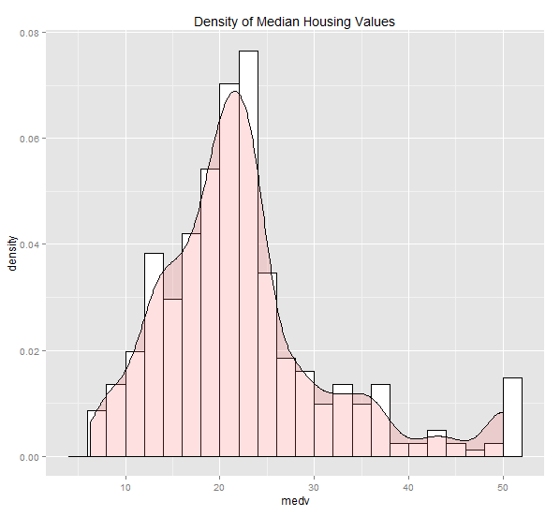
Exploratory Data Analysis Continued:
Histogram and the density plot of median house values:

Slide 7
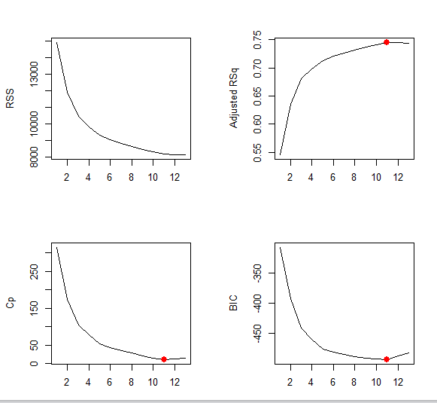
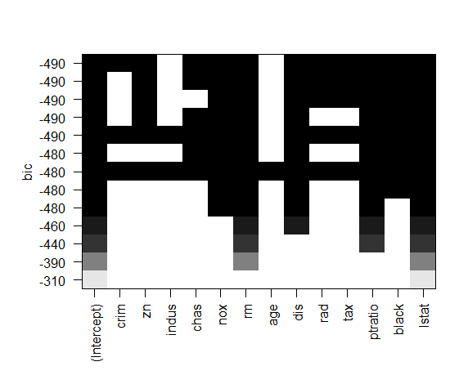
Variable Selection
The Best Subset method:- Using BIC criterion selecting 11 variable seems
good option, which minimizes the BIC value.

Slide 8
Variable Selection Continued
The Best Subset method:- Using BIC criterion selecting 11 variable seems
good option, which can minimize the BIC value.
Following are the 11 variables with their parameter estimates
(Intercept) | crim | zn | chas | nox | rm
41.1261 | -0.0946 | 0.0501 | 2.3793 | -15.3829 | 3.2288
dis | rad | tax | ptratio | black | lstat
-1.5629 | 0.3084 | -0.0124 | -1.010 | 0.0096 | -0.5941

Slide 9
Key Model Parameters:
Multiple R-squared: 0.7357, Adjusted R-squared: 0.7283
F-statistic: 99.43 (11 and 393 df), p-value: < 2.2e-16
As the Adjusted R-squared value is 0.7283, we can say model has a good fit.
As the F-statistic value is 99.43 and p-value < 0.05, we can say all the coefficients are jointly significant and not all are zero.
Mean squared error (train data) = 20.13087 and Mean absolute error (train data) = 3.204237

Slide 10
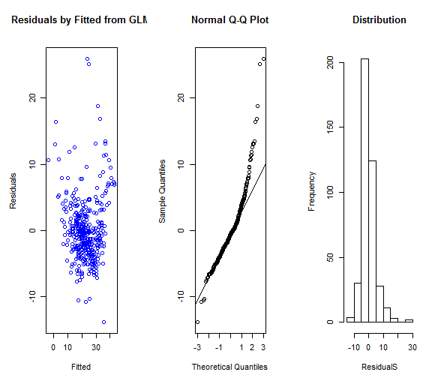
Residual Analysis:
*As the residuals are randomly scattered, we can say the residuals follow constant variance. From the Q-Q plot and the histogram we can observe that the residuals follow normal distribution.

Slide 11
Out of Sample Performance:
Mean squared error (test data) = 29.86581 and Mean absolute
error (test data) = 3.762129
As expected, MSE values are higher with testing data than training data.

Slide 12
Cross Validation
Using K= 10 to perform 10 fold cross validation on the 11 predictor variables
Following results were obtained
Mean Square Error: 23.17568
Observation: We could see the reduction of MSE to a greater extent in cross fold validation technique compared to normal regression model evaluation using test data.

Slide 13
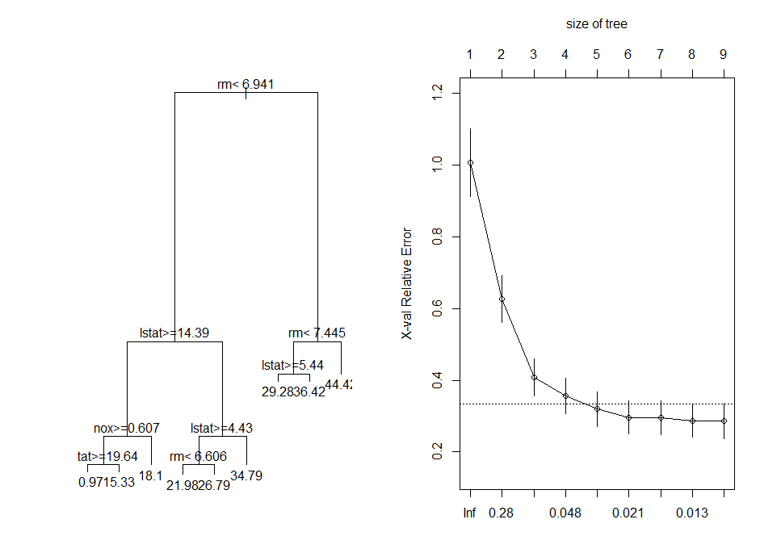
CART models:
Based on the plot right side. We can chose complexity parameter (Cp) value such that it reduce cross validation error to a greater extent v/s change cp value. Here we can chose cp value 0.01349 to the corresponding 6 tree splits.

Slide 14
Out of Sample Performance:
Mean Square Error: 21.58174
Comparison of performance across models:
Model | MSE
Regression | 29.86581
Cross Validation | 23.17568
Regression Trees | 21.58174
So, from MSE values we obtained from three different models, CART model gave the best fit with MSE of 21.5

Slide 15
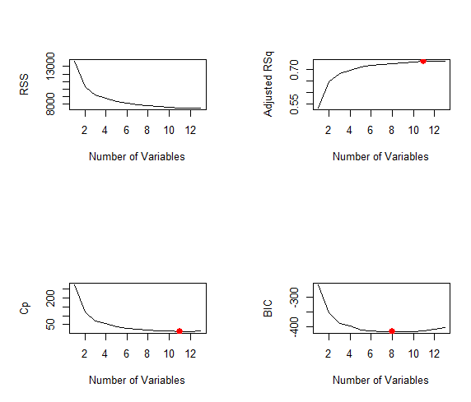
Repeating the entire procedure with Training data = 70%, Test data = 30%. Following results were obtained…
..
Based on BIC criteria, we have included 8 variables to be included in the model compared to 11 variables in the previous model.
Model Parameters:
Multiple R-squared: 0.7337, Adjusted R-squared: 0.7276 :
Model has a good fit.
F-statistic: 119.2 on 8 and 346 DF, p-value: < 2.2e-16 : Implies all variables are collectively significant

Slide 16
Thank You

